Slide 1
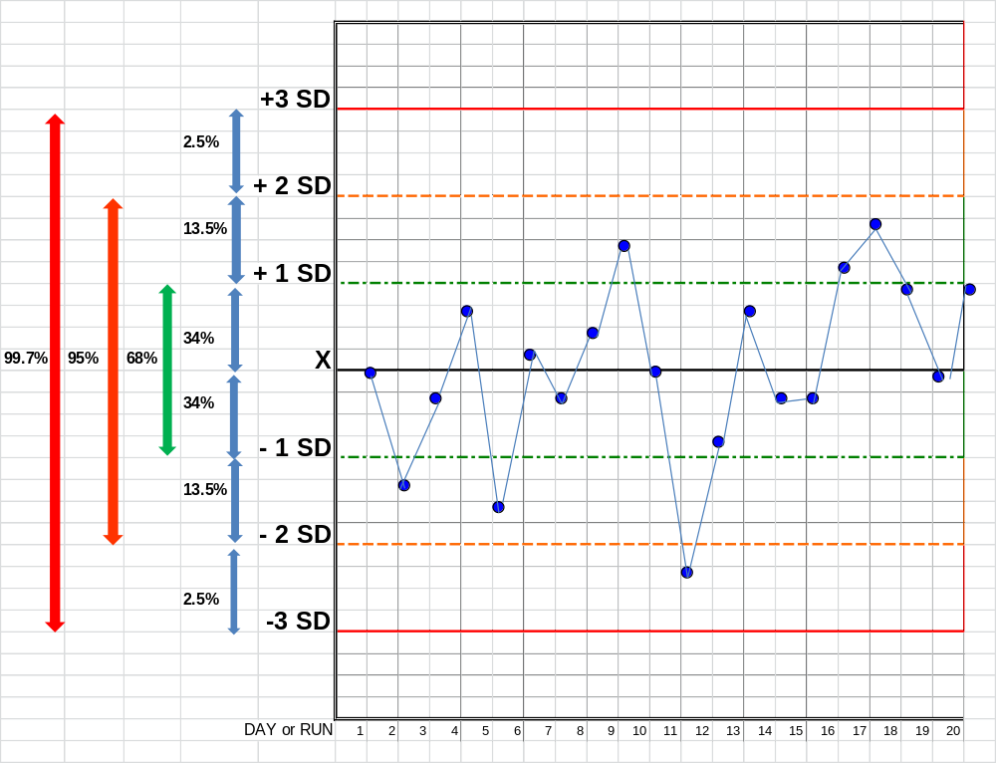
Notes:
Normal Distribution

